Slide 1
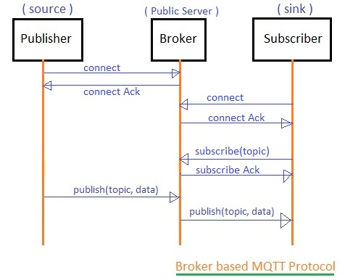
Paho MQTT
MQTT (Message Queuing Telemetry Transport) is an ISO standard (ISO/IEC PRF 20922) publish-subscribe-based messaging protocol. It works on top of the TCP/IP protocol. It is designed for connections with remote locations where a "small code footprint" is required or the network bandwidth is limited.
pip install paho-mqtt

Slide 2
Publish.py
import paho.mqtt.client as paho
import os
import socket
import ssl
from time import sleep
from random import uniform
connflag = False
def on_connect(client, userdata, flags, rc):
global connflag
connflag = True
print("Connection returned result: " + str(rc) )
def on_message(client, userdata, msg):
print(msg.topic+" "+str(msg.payload))
mqttc = paho.Client()
mqttc.on_connect = on_connect
mqttc.on_message = on_message

Slide 3
Publish.py (contd.)
awshost = "a1t7wpltysp7gc.iot.us-east-2.amazonaws.com"
awsport = 8883
clientId = "Iot1"
thingName = "Iot1"
caPath = 'VeriSign-Class 3-Public-Primary-Certification-Authority-G5.pem.txt'
certPath = 'abeeb26700-certificate.pem.crt'
keyPath = 'abeeb26700-private.pem.key'
mqttc.tls_set(caPath, certfile=certPath, keyfile=keyPath, cert_reqs=ssl.CERT_REQUIRED, tls_version=ssl.PROTOCOL_TLSv1_2, ciphers=None)
mqttc.connect(awshost, awsport, keepalive=60)
mqttc.loop_start()
for i in range(50):
sleep(0.5)
if connflag == True:
topic = input("Please enter iot code to publish:\n")
message = input("Please write message to publish:\n")
mqttc.publish(topic, message, qos=1)
print("\nmsg sent")
else:
print("waiting for connection...")

Slide 4
Subcribe.py
import paho.mqtt.client as paho
import os
import socket
import ssl
def on_connect(client, userdata, flags, rc):
print("Connection returned result: " + str(rc) )
# Subscribing in on_connect() means that if we lose the connection and
# reconnect then subscriptions will be renewed.
client.subscribe("#" , 1 )
def on_message(client, userdata, msg):
print("topic: "+msg.topic)
print("payload: "+str(msg.payload))
mqttc = paho.Client()
mqttc.on_connect = on_connect
mqttc.on_message = on_message

Slide 5
Subcribe.py (contd.)
awshost = "a1t7wpltysp7gc.iot.us-east-2.amazonaws.com"
awsport = 8883
clientId = "Iot1"
thingName = "Iot1"
caPath = 'VeriSign-Class 3-Public-Primary-Certification-Authority-G5.pem.txt'
certPath = 'abeeb26700-certificate.pem.crt'
keyPath = 'abeeb26700-private.pem.key'
mqttc.tls_set(caPath, certfile=certPath, keyfile=keyPath, cert_reqs=ssl.CERT_REQUIRED, tls_version=ssl.PROTOCOL_TLSv1_2, ciphers=None)
mqttc.connect(awshost, awsport, keepalive=60)
mqttc.loop_forever()

